Slide 1
Impacts of Synchronous Generator Capability Curve on Systems Locational Marginal Price through a Convex Optimal Power Flow
First International Virtual Conference on Multidisciplinary Research 2018
Author: Italo Fernandes

Slide 2
Introduction
This work will present a market analysis in locational marginal prices through a non-conventional OPF method using a convex approach from SOCP relaxation, including in it constraints SGCC limits. Text is structured as follows. In the second section will be shown the nonlinear optimal power flow (ACOPF) formulation and it also introduce SOCP relaxation summed up. Section 3 involves the study and equations of SGCC. Simulation and analysis will be found in Section 4. Simulations were held in MATLAB® using its optimization tools for solving both: convex and non-linear OPF.

Slide 3
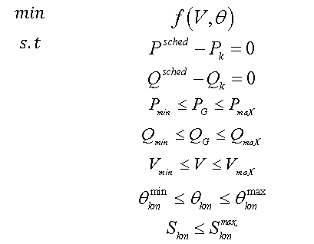
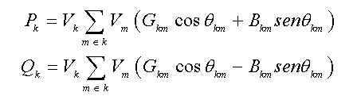
ACOPF Formulation

Slide 4



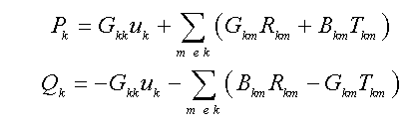
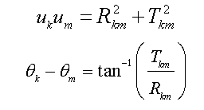
SOCP OPF Relaxation

Slide 5
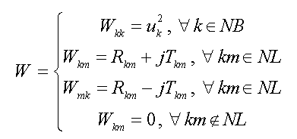
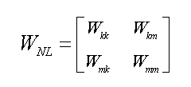
Hermitian Matrix

Slide 6
Synchronous Generator Capability Curve
The capacitance curve (capacity curve or D-curve in other literature) is a selection of important curves for the actual operation of the synchronous generator, with respect to the steady-state analysis. It defines the region of practical operation of the machine, preventing it from operating under overload conditions [8], [9].
The most explored limits in the bibliographies cover only limits of armature current and field. However, other limits are also important for the operation of the synchronous machine, such as mechanical turbine power limits, permanent stability limit and minimum excitation current threshold. [10,11,12]

Slide 7
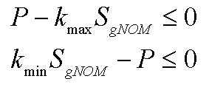

Prime Mover Mechanical Power Limits
Mechanical power limits is verify due the maximum stress that prime-mover can stand without suffer damage in its structure. This constraint will be defined through a constant value on $P$ axis in the diagram. Given a mechanical nominal power $S_{gNOM}$for generators turbine the constraints will be:

Slide 8

Armature Current Limit
This limit can be modeled based on the relation of apparent, active and reactive power. Basically, when machines operate in a constant terminal voltage value, its armature current limits is stablished through its winding thermal limits. So, its noticeable that this constraint is a circumference centered in the origin [2]:

Slide 9
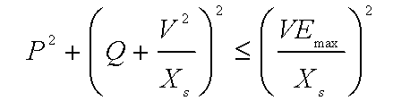

Field Current Limit
In the same way when current field is maximum (due its winding thermal limits) and consequently voltage field is maximum, the constraint becomes a circumference centered in $−V^{2}/X_{s}$:[2]

Slide 10
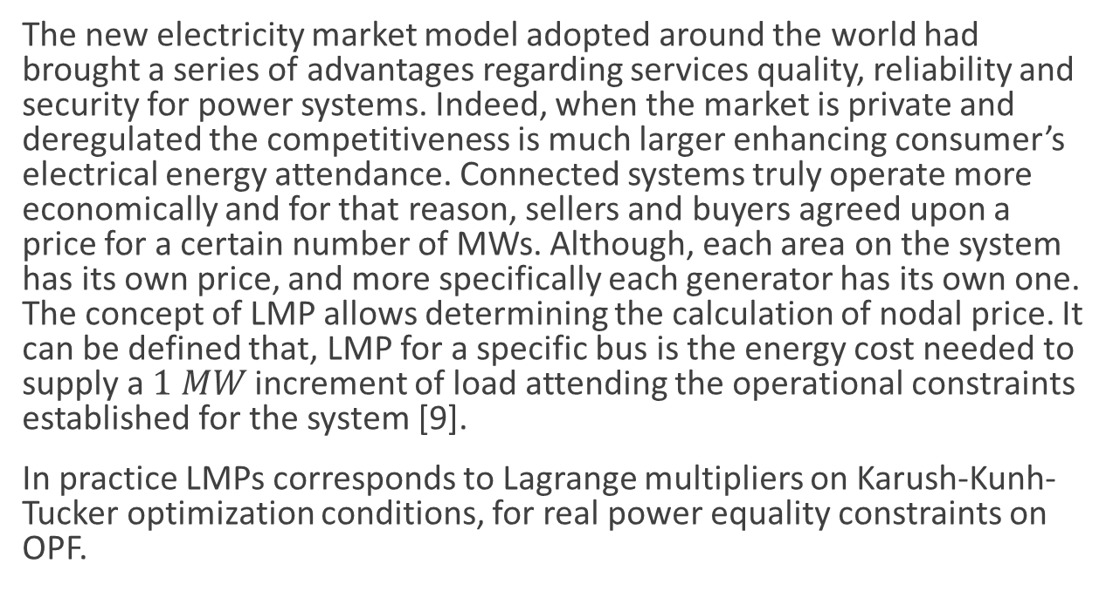
Locational Marginal Prices
The new electricity market model adopted around the world had brought a series of advantages regarding services quality, reliability and security for power systems. Indeed, when the market is private and deregulated the competitiveness is much larger enhancing consumer’s electrical energy attendance. Connected systems truly operate more economically and for that reason, sellers and buyers agreed upon a price for a certain number of MWs. Although, each area on the system has its own price, and more specifically each generator has its own one. The concept of LMP allows determining the calculation of nodal price. It can be defined that, LMP for a specific bus is the energy cost needed to supply a $1 MW$ increment of load attending the operational constraints established for the system [9].
In practice LMPs corresponds to Lagrange multipliers on Karush-Kunh-Tucker optimization conditions, for real power equality constraints on OPF.

Slide 11
Numerical Results
The proposed method was simulate using IEEE-14 bechmark system [12]. For these four situations were held: ACOPF including or not SGCC, and SOCP-OPF including or not SGCC. For all cases five scenarios of loading were take variating both, active and reactive power. All of them had its main results registered in Table 4. Although just 50%, case base and 150% of loading are specifically analyzed in Table 1-3. Tables register active and reactive powers and locational marginal prices for several situations regarding to a complete analysis.

Slide 12
Numerical Results

Slide 13
Numerical Results

Slide 14
Numerical Results

Slide 15
Numerical Results

Slide 16
Numerical Results

Slide 17
Numerical Results
For classical constrains Optimality gap is around 0.072 and 0.316%. Including SGCC constraint in OPF, values are in a range of 0.16 to 7.5%. In Table 3 computational running time its found to be much greater for SOCP-OPF if compared to ACOPF, when SGCC is included. This implies that solver technology stil needs to be improved for time equality in the process. Comparing just constraints modifications, computational time is not a problem.
When system load is low, and the system is lightly loaded OPF including SGCC gives a high cost.
For heavy loading situations classical constraint gives a lower cost.
This can simply be explained for the fact that reactive limits are larger and minimum mechanical power is greater when taking SGCC approach. In high loading levels the relaxed method has to work hardly to find a feasible solution, and sometimes cannot reach convergence.

Slide 18
Numerical Results
LMPs are shown in Tables 1 to 3 for both OPF and for models including or not SGCC constraints. Note that for case-base and 150% loading LMPs practically do not change. Although, for 50% loading case LMPs are lower when OPF includes SGCC.

Slide 19
Conclusion
This work exposed a relaxed formulation for Optimal Power Flow including Synchronous Generator Capability Curve constraints, that modeled machines practical bounds. Simulations showed that optimality gap is very short for both formulations. It was shown that for heavy loading levels, relaxed OPF works harder to find a feasible solution. SGCC gives directions for systems operators and planners in respect to availability of active and reactive power plant. Scenarios that SGCC are not concerned could either takes generator to fail in its operations due protection system actuating or damage windings when protection is note involved. Besides, obviously the model that uses SGCC will gives a high LMP, which implies that when it is not considered could offer a fake price for generators power. Results for OPF including SGCC constraint can be analyzed as follow:

Slide 20
Conclusion
Draw a situation dealing with overprice in light loading scenarios, or;
Drives the result to a down price in heavily load conditions.
Simulation time need to be improved, but this just could be done adjusting the solver technology. That is why it is much larger for the relaxation and still greater when SGCC is included. In these specific cases, LMPs are lower just when loading is 50% of case-base loading, but this situation depends on optimal power flow power limits data.

