Slide 1
A Development of Agility Mode in Cardiopulmonary Resuscitation Learning Support System Visualized by Augmented Reality
Kushiro Public University
Keisuke Fukagawa Yuima Kanamori
Akinori Minaduki

Slide 2
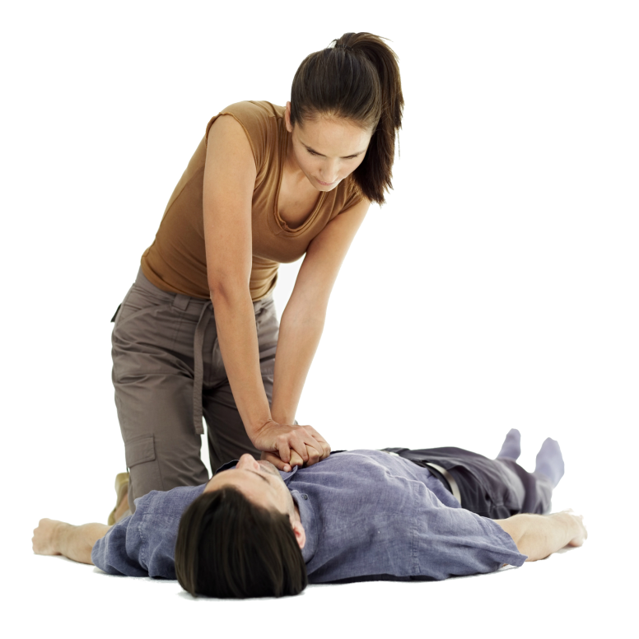
What is CPR?
CPR is Cardiopulmonary resuscitation
CPR contributes to rescue person in
cardiac arrest
The criterion of CPR comes from
the Drinker curve

Slide 3
The necessity of CPR
Mortality
（％）
0%
6%
9%
15%
Time
（min）

Slide 4
The Regulation of CPR
Compression depth is at least 5 cm but no more than 6 cm
Perform at 100–120 repetitions per minute
Unceasingly perform with minimal interruption time (≤10 s)
Be perpendicular from the elbow joint to the base of the palm
CPR is individualized by target (e.g. CPR for infants)

Slide 5
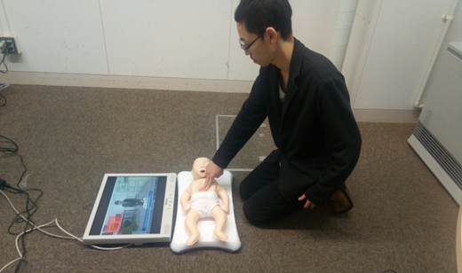
CPR For Infants
The criteria of CPR of infants are quite
different from that of adults.
1.Learners have to do CPR by using
two fingers in the middle of two nipples.
2.The depth of compression is one
third of their body.

Slide 6
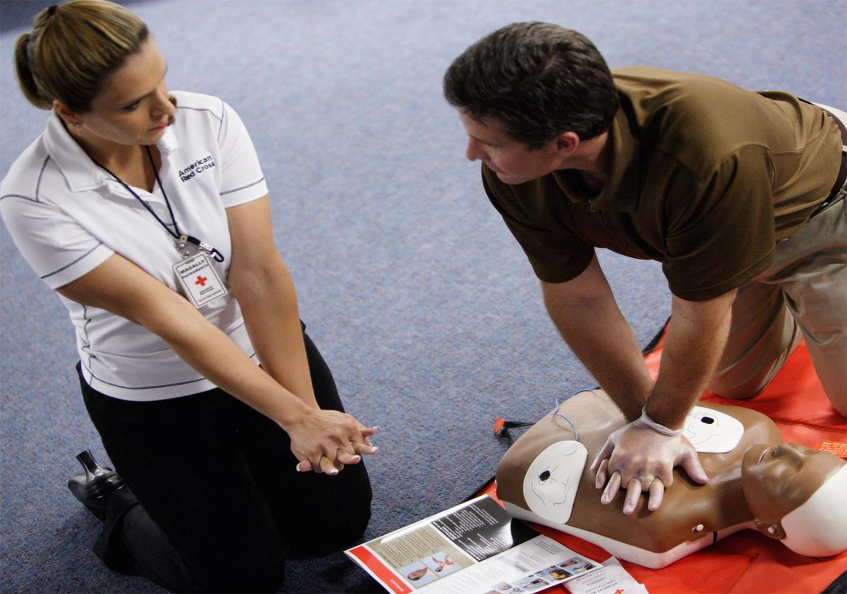
General CPR training
How much stronger is it ?
Learners are taught by some instructors
in a subjective judgment.
They cannot confirm whether their CPR is appropriate or not objectively.
We made a CPR system to evaluate
learner’s CPR objectively
Press more strongly!

Slide 7
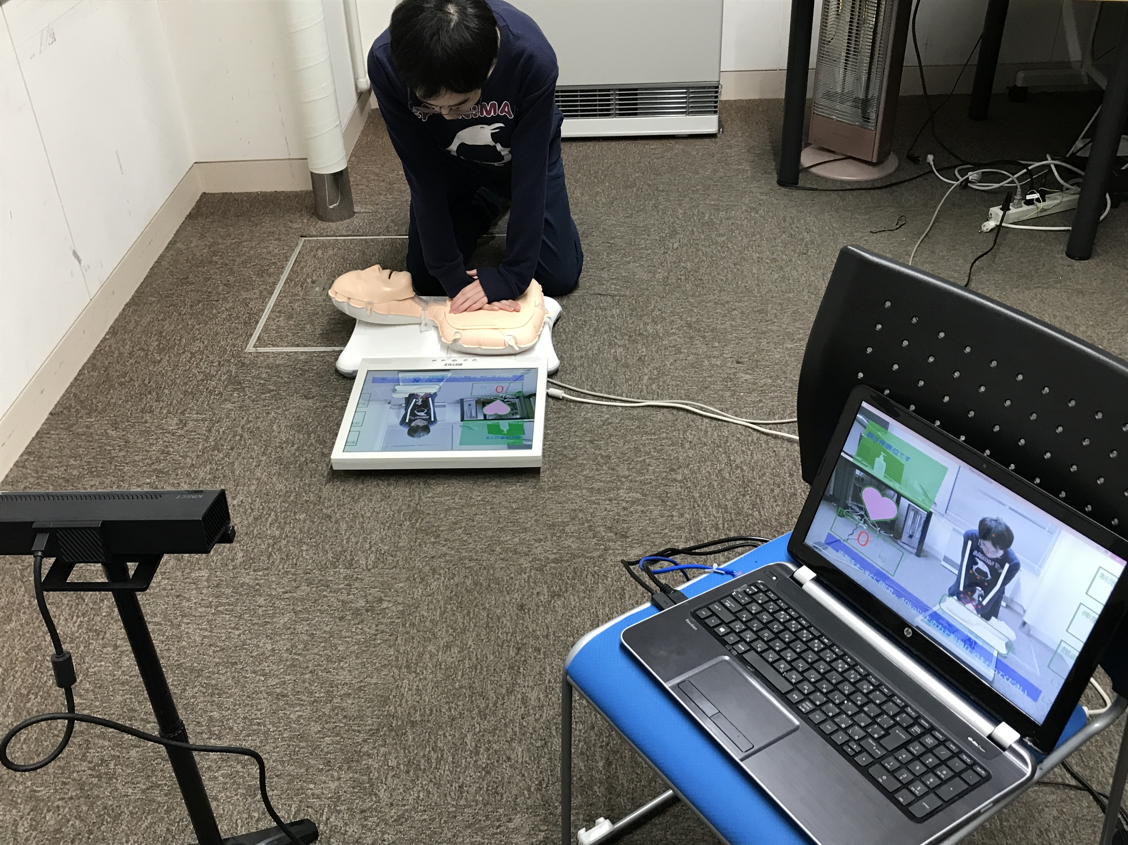
Our CPR training system
MiniAnne
(Mannequin)
Wii Balance Board(Pressure)
HDD
(Visualization)
Kinect version2
(Posture)
Windows PC (Control)

Slide 8
Demonstration

Slide 9
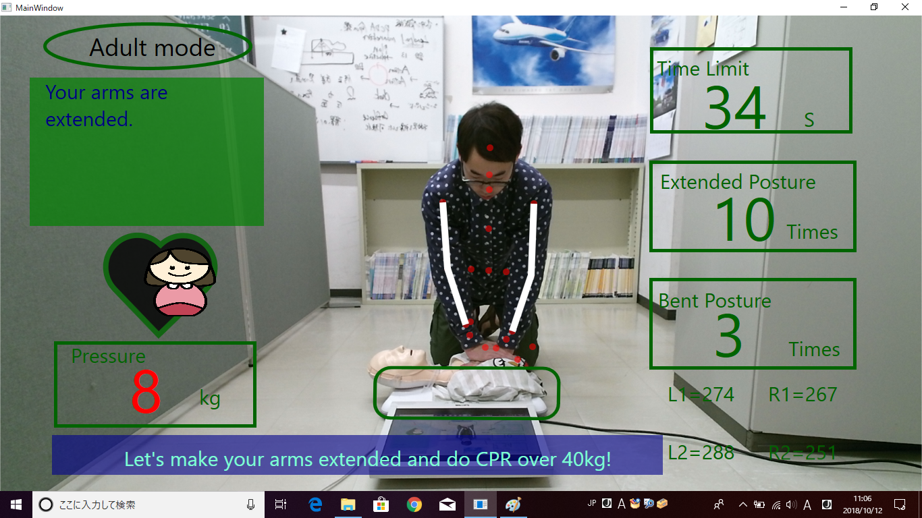
Interface of our system
Timer(60s)
Posture
(Extension or Bending)
Counts of extension position Pressure
Heart Mark
(A standard of the pressure)
Counts of bending position Pressure
Precise pressure
Instruction
Coordinate of arms

Slide 10
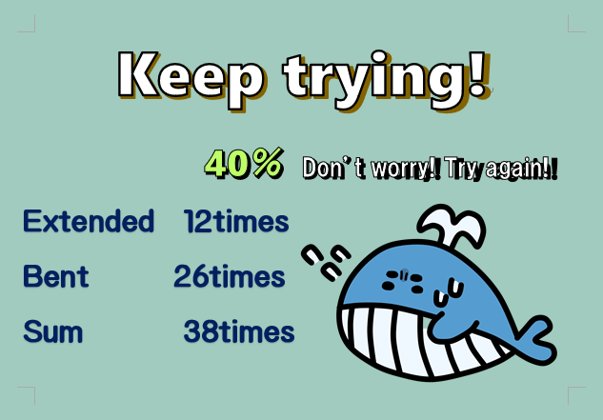
The classified results

Slide 11
Questionnaire results
Men 33 Women 51 (Adults) A total of 84 people
*Percentage of people who answered Yes
Q1. Have you ever participated in the lecture class of CPR training? ７５％
Q2. Did you know a specific way of CPR for infants
before participating the lecture?
All ４５．３１％
Only general public １２．１２％
Only childcare worker ９３．１０％
Q3. Do you mind doing the CPR for the opposite sex?
Men ５２.１７％ Women １９.５１％
Q4. Was the CPR training system useful? ９８.４４％
Q5. Were you able to study the CPR training with enjoying? ９２.１９％
CPR for infants is not recognized by the general public
Between women and men ,there is a 32% difference of hesitancy

Slide 12
The Data of the inspection
Kg
Kg
1st : White Line
2nd: Gray Line
3rd : Black Line
＊ : Bent Position Pressure
Times
Times
This verification clearly represents an effect by using the CPR training system because the pressure of compression of the research subject became more stable in an appropriate level, and the number of compression increased.

Slide 13
consideration
We can say the visualization like our system contributed to gaining self-confidence about doing CPR themselves.
They will improve their CPR because they can get the fixed information from devices again and again.
There is a individuality in CPR. Considering to the result of questionnaire.

Slide 14
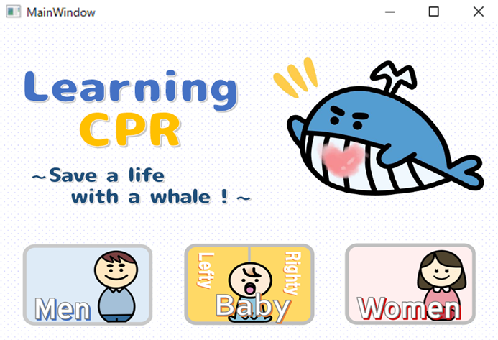
Conclusion
In this research , objects(men, women, babies) of this system could be classified as different ones. This progress is a first step to prevail the presence of CPR for general public. Another function is going to be added to the present system to evaluate CPR in a process.
For example ,we add CPR system for elderly in our Agility Mode

Slide 15
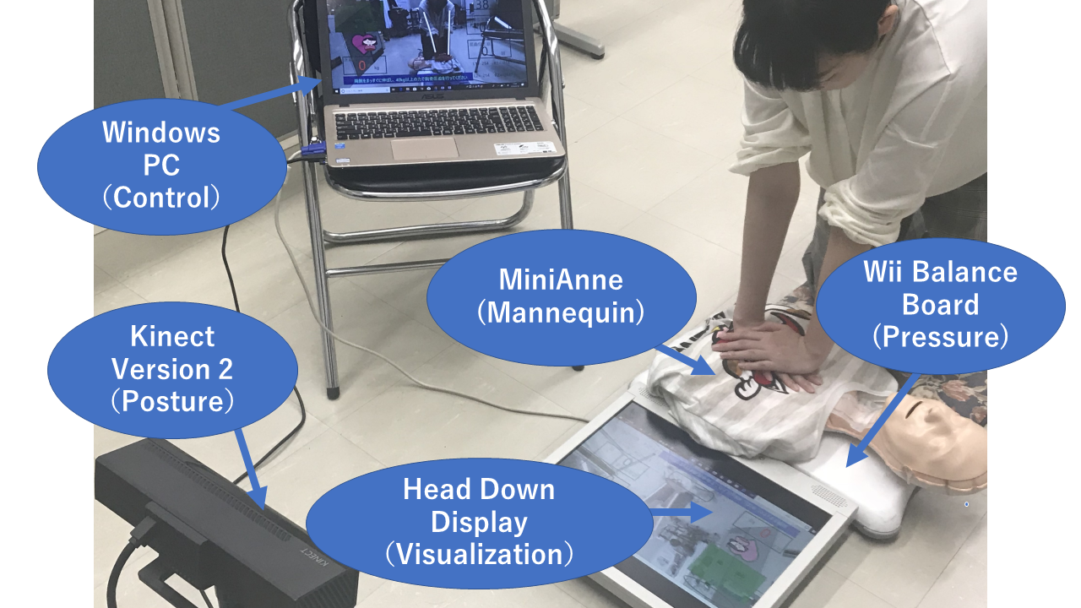
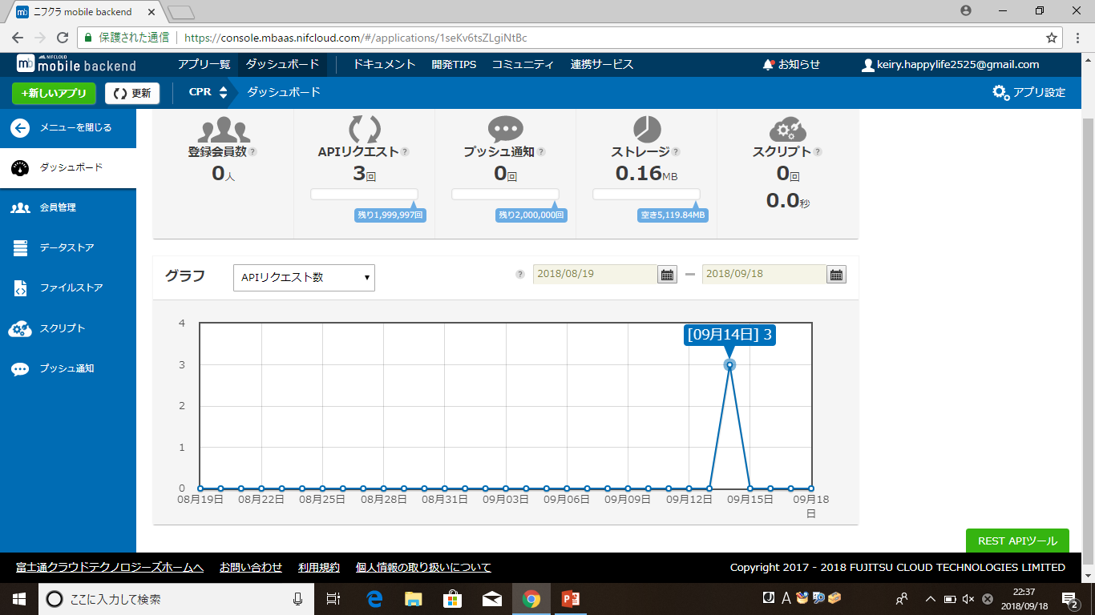
Future work
Nifty Cloud Mobile backend
*Wi-fi is required
・Preliminary learning is possible in waiting time
・Send learning results to the application

Slide 16
Thank you for Listening!!

