Slide 1
ANALYSIS REFACTORING WITH TOOLS
First International Virtual Conference on Multidisciplinary Research 2018
Zhala Sarkawt Othman
From: Erbil, Iraq
Master Student in Firat University Elazig, Turkey
e-mail: zhala.sarkawt@gmail.com).
11/12/2018

Slide 2
Contents
INTRODUCTION
METHOD AND MATERIALS
RESULTS
DISCUSSION AND CONCLUTION

Slide 3
INTRODUCTION
Refactoring is a technique of fluctuating the now prevailing basis codes using an unconventional as well as the incremental system.
The universal comportment of the code is not reformed through refactoring.
Refactoring is advantageous as its reprocess results in either the refactored code being definitely employed in a more advanced way or for an additional tenacity.
11/12/2018

Slide 4
INTRODUCTION
Refactoring Having a refactoring tool arranges for a much indispensable sustenance in scrutinizing a code rather than doing it manually. This is because manual refactoring consumes a lot of time.
The refactoring process must be in route with the common comportment of the programs set in place.
The program writer is tasked with the choice of providing an eminence work at a cognizant time interval. Much of the statistics is already known to the programmer.

Slide 5
METHOD AND MATERIALS
A project analyzer is a refactoring tool that is essential to refactoring already in place Visual basic code. This tool has substantiated to be useful in various ways.
As a refactoring tool, the scheme analyzer also completes robotically a splinter of the refactoring.
A number of vagaries in the codes entail mortal consideration, therefore, making a refactoring to be completed by hand.

Slide 6
METHOD AND MATERIALS
There are some existing refactoring tools for the most widely used modern languages, such as Java, C# and C++, mostly as refactoring browser plug-ins to the most mainstream IDEs (e.g., Microsoft Visual Studio or Eclipse).
In addition, the database logic is not related to the fundamental code that it is initially written. It is easy to read the source code with the aid of the flowchart.
The flowchart assists to refactor the codes to systems that are easily decipherable plus increased.

Slide 7
METHOD AND MATERIALS
Notes:
The (flowchart 1) about Refactoring Process. This makes a graphic construal of the code to be more favored since it divulges designs which can be distinguished in the source code.

Slide 8
METHOD AND MATERIALS
Refactoring Technique | Meaning in Life
Extract Method | This allows you to define a new method based on a selection of code statements.
Encapsulate Field | Turns a public field into a private field encapsulated by a .NET property.
Extract Interface | Defines a new interface type based on a set of existing type members.
Reorder Parameters | Provides a way to reorder member arguments.
Remove Parameters | As you would expect, this refactoring removes a given argument from the current list of parameters.
Rename | This allows you to rename a code token (method name, field, local variable, and so on) throughout a project.
Promote Local Variable to Parameter | Moves a local variable to the parameter set of the defining method.
Notes:
The refactoring techniques streamline methods, remove code duplication, and pave the way for future improvements.
In (Table 1) the following are examples of simple refactoring in Visual Studio.

Slide 9
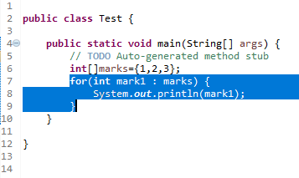
Example of "Extract Method" Refactoring
1. We will select the following range of code inside the Test (Class):
Notes:
This example of the "Extract Method" Refactoring. We use one of the tools in programming to improve the code in order to make the intent of the code clearer; you will extract the code that collects test cases from base classes into a new method called “printmarks”.

Slide 10
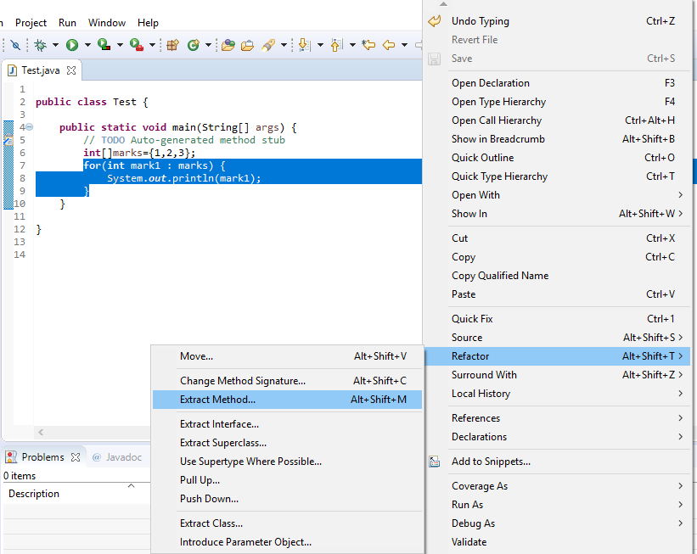
Example of "Extract Method" Refactoring
After we select three lines of the code from the selection's context menu in the editor; select Refactor > Extract Method or using (Alt+Shift+M) for the refactoring Extract Method:

Slide 11
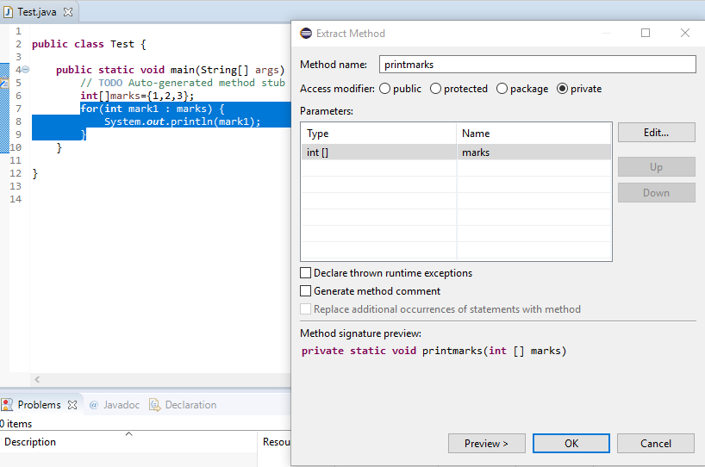
Example of "Extract Method" Refactoring
In the Method Name field, type printmarks:

Slide 12
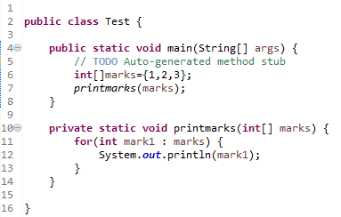
Example of "Extract Method" Refactoring
After refactoring, we get a cleaner and more readable code:

Slide 13
RESULTS
The important part of the test is to make sure that your application performs efficiently and responsibly. This is where code analysis and profiling tools and techniques are evaluated: allows you to evaluate your code for errors, bottlenecks, and efficient use of processing and memory resources. Modern code recognizers can direct you to the exact lines of code that need to be resold.
The re-export tools change between IDEs and software programs. Visual Studio contains embedded built-in analysis tools.

Slide 14
DISCUSSION AND CONCLUTION
The use of the hide method by the project analyzer allows the detection of excess method scope. It also suggests how to make the procedure private where it is convenient.
This procedure can also be done by making the variable to be local. The cases for substitute nested conditional with guard clauses, the project analyzer is able to identify unwarranted conditional nesting.
This is essential to understanding the steps taken in its execution, making it easier to read.
11/12/2018

Slide 15
DISCUSSION AND CONCLUTION
The procedure of using the manual as a refactoring tool is long. This is with the inclusion of a similar line of code in various locations.
In the case where a logical structure exists in more than two procedures which may be as a result of duplication and pasting of the codes.
The multifaceted expressions formed are easily detected in a flow chart.
It provides a suitable platform for the logic to be rewritten in a simpler manner.
11/12/2018

Slide 16
Please do not hesitate to contact me if you have any questions.
Zhala Sarkawt OTHMAN, Elazig 23119 Turkey,
e-mail: zhala.sarkawt@gmail.com).

