Slide 1

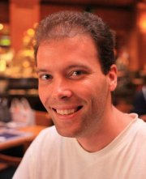
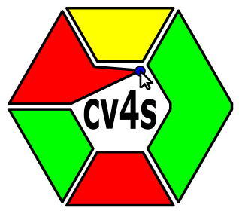
cv4sensorhub
A multi-domain framework for
semi-automatic image processing
Kristóf Csorba, Ádám Budai
Budapest University of Technology and Economics
kristof@aut.bme.hu
(The presentation contains notes and recorded audio.)
Budapest University of Technology and Economics
Notes:
My presentation is mainly about automation.
Automation by IT technology in several interdisciplinary applications, so that other discipline’s researchers can benefit
from state-of-the-art image processing and software automation, without the need to learn about software development themselves.

Slide 2
Levels of automation in research
Typical levels of automation in non-IT related disciplines:
Generic applications: Gimp, PhotoShop, Excel...
Domain specific generic applications: microscopy manufacturers, medical MRI analysis software (lucky ones, focus topics)
Scriptable applications: IntelliJ
(needs basic programming skills)
Research specific application
Notes:
If a researcher of a non-IT related discipline wants to automate their everyday workflow, there are several opportunities:
One can take a generic software solution like image manipulation tools (Gimp, PhotoShop) or data processing applications (Google Sheets, Excel). These are highly advanced tools, but being generic also means that research specific functions are rare. One has to copy-paste, transform, edit the data at several points during work.
Lucky researchers have software support for their measurement equipment like microscopic image processors created by microscope manufacturers, MRI image analysis software with highly advanced medical image processing, GIS systems with a wide range of tools to manipulate spatial data. There is a good chance that the amount of manual work remains low in these cases. But this works only in domains having many users and/or significant financial background.
Less lucky disciplines can use scriptable applications, if the research group is familiar with basic programming techniques. ImageJ for image processing and the Python based tools provide a huge advantage for those who master them.
As research is aiming for new application areas and answering new questions, big manufacturers have to find a balance between research-specific solutions with few users and sufficiently generic solutions with much more potential users. This way, the most aligned software is the one created by the research group itself.
My presentation is about cases where there is a software solution for exactly the purposes of the given research.

Slide 3
Research specific application
IT is for automating things... anything.
Let’s combine our forces: let an IT engineering team automate the workflow of research groups in other disciplines!
(Needs a software engineering team
who understands the basics of the other discipline!)
Results: feasible, faster evaluation
Opening research directions which had the “unfeasible” stamp before...
Notes:
These software are aligned to the everyday workflow, thus highly automating most of the steps.
IT engineering is a discipline aiming for automating... automating anything. It is only interesting if we apply it for interesting things. In my presentation, I will show how a co-operation with IT engineers (software developers) can result in successful research projects in some image processing related areas. It may be successful even by accelerating the tedious workflow and thus making the work more feasible, scalable. Or it may even open new opportunities which were previously marked as being “unfeasible” as they require an enormous amount of manual work.
But there is a very important requirement for doing this: the IT engineering team needs to have sufficient domain knowledge, otherwise the two sides will not understand each others expectations and preferences.
This is a significant threshold, as many software developers are not very motivated in learning about phase-contrast microscopy or sandstone porosity. But luckily, there are also many exceptions. ☺

Slide 4
What do we need for that?
Handy user interface, so that everyone can use it.
Semi-automatic operation for full control, the foundations of trust towards the results!
Reasonable price for development
  Reusable framework
  Sufficiently customizable
  Extendable for the application domain
Notes:
What do we need as a domain specific application?
Of course we need a handy user interface which can be used without technical magic skills.
The end users need to trust the results given by the software. How can we use a software for accurate measurements, if it is fully automatic and it is said to find the right properties with 90% accuracy? This accuracy may be enough, but still:
what if I have bad luck and my images are misinterpreted by the software and it gives a very bad result. How will I recognize this? For example if it says that the average grain diameter is 1.3mm... did it really count all grains and measure them properly? How did it handle the grains at the borders of the image? Is that documented?
and what if I need more than 90% accuracy?
Trust can be easily achieved by giving the user full control: if they can check and manually correct every step the software does, maybe sometimes there will be more work to do, but all mistakes can be fixed in time! This leads to the accuracy of the human expert, but usually with significantly less manual work. This is why one of our key goals is semi-automatic processing.
And the price?
As software development can be very expensive, achieving these goals requires preparations: reusable software components, customizable user interfaces, and a software architecture which can be easily extended for the purposes of as many domains as possible. This way, the development time gets shorter and the price gets feasible.

Slide 5
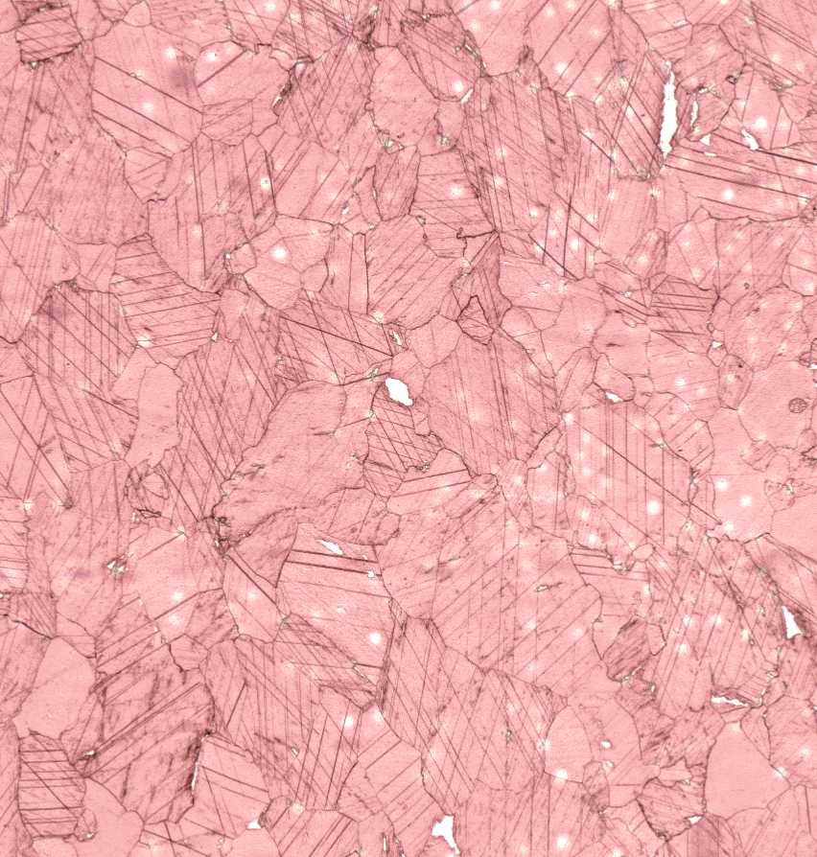
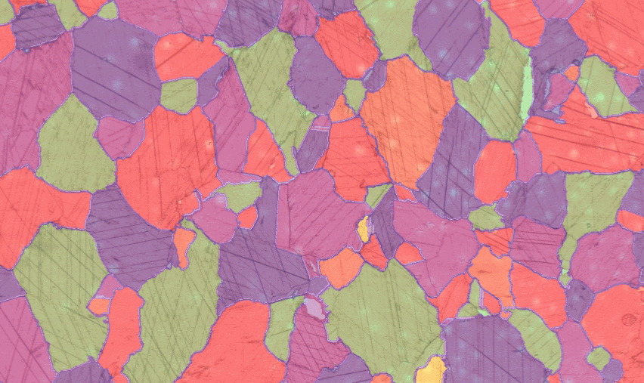
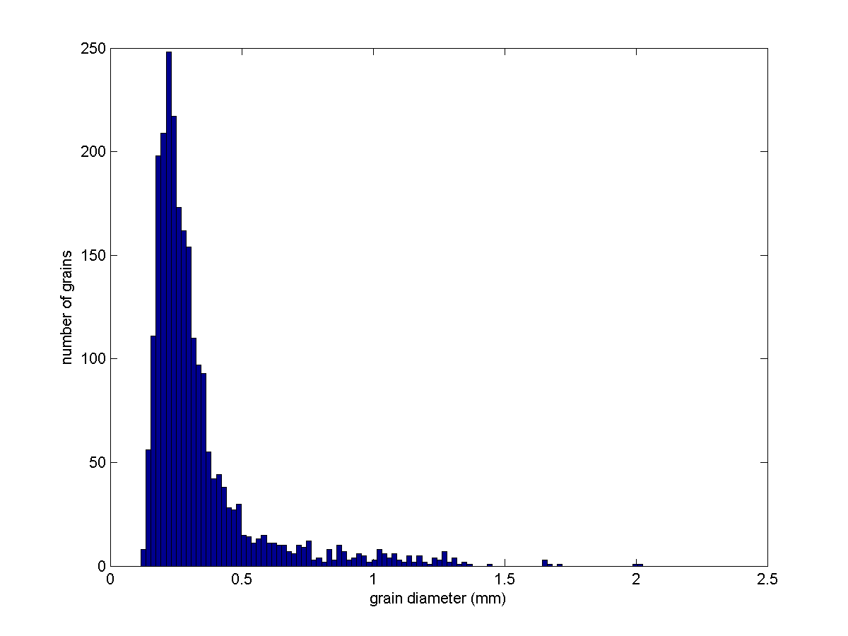
The beginning: marble thin sections
Notes:
The whole story began with a discussion with geologists who needed the grain diameter histogram of marble thin sections for marble provenancing purposes.
If the grains inside the image can be identified, the diameter histogram can be calculated.
Their problem was the presence of twin crystals: these create usually straight, parallel lines inside the grains. As these are not grain boundaries, they confuse traditional edge detection based grain boundary identification.

Slide 6
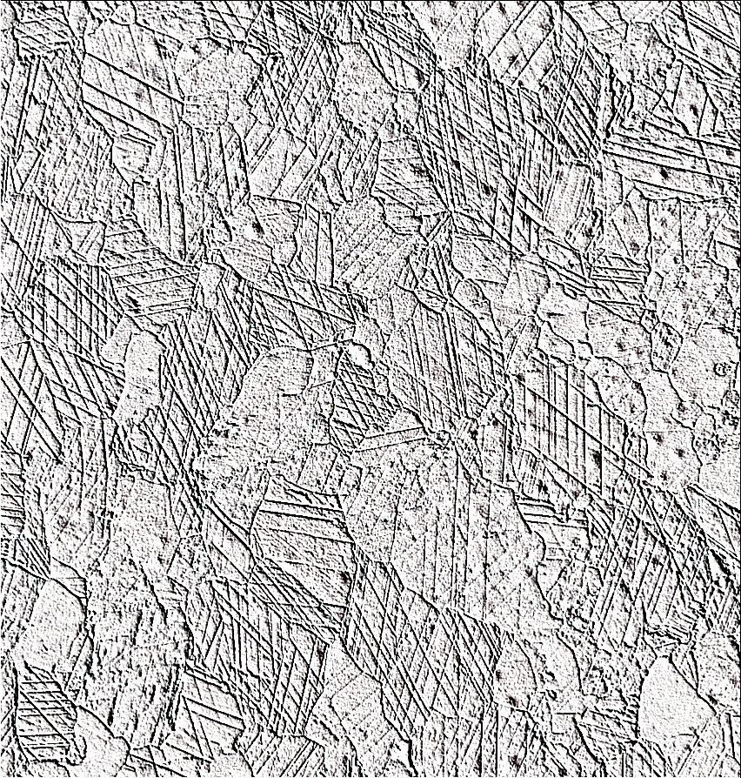
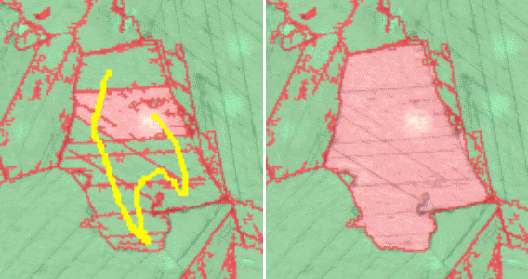
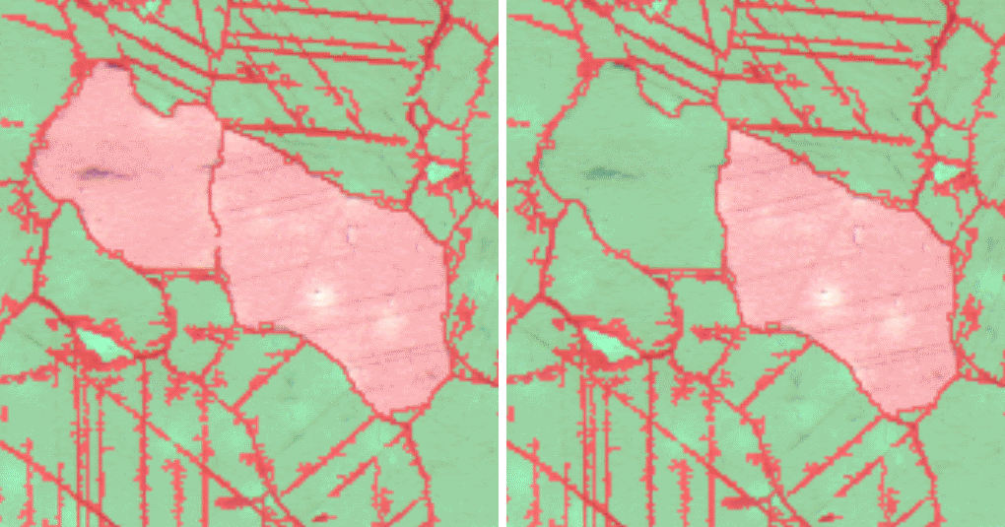
Tools for semi-automatic processing
Notes:
On one hand, we started to develop twin crystal line detection.
We knew that it would be unrealistic to assume that it will be 100% perfect. But that degrades the measurement results!
So we decided to aim for a semi-automatic approach: after the automatic processing, the result is presented to the user like in a special drawing program. And here, the user has tools to quickly check, merge or split the grains if needed.
Merging only needs a rough stroke with the mouse to mark the grains to be merged. After this hint, the program does it nicely and smoothly.
Slicing two grains merged by a small gap in their boundary only needs the mouse to be above the grain and pressing a hotkey starts the automatic slicing: it finds the narrowest gap between the parts of the grain and fills it.
Integration of domain specific knowledge into the application is essential here: the work can be effective because the software knows that we are working with marble thin sections. It is not a generic solution.

Slide 7
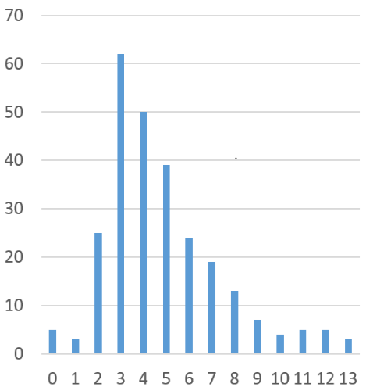
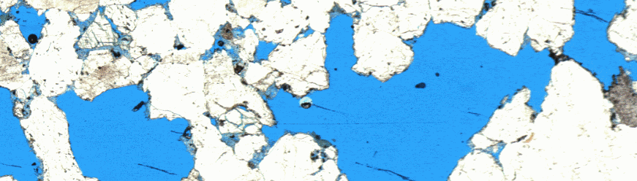
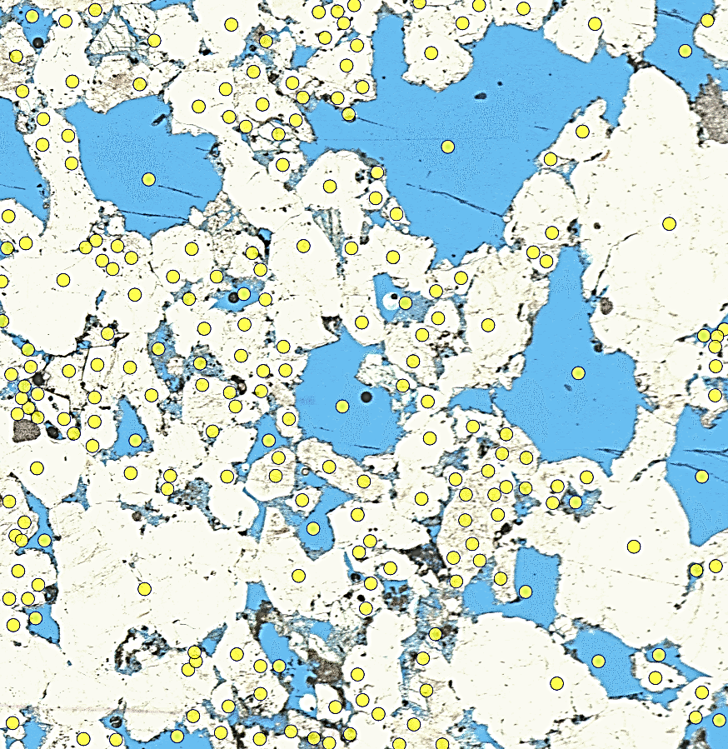
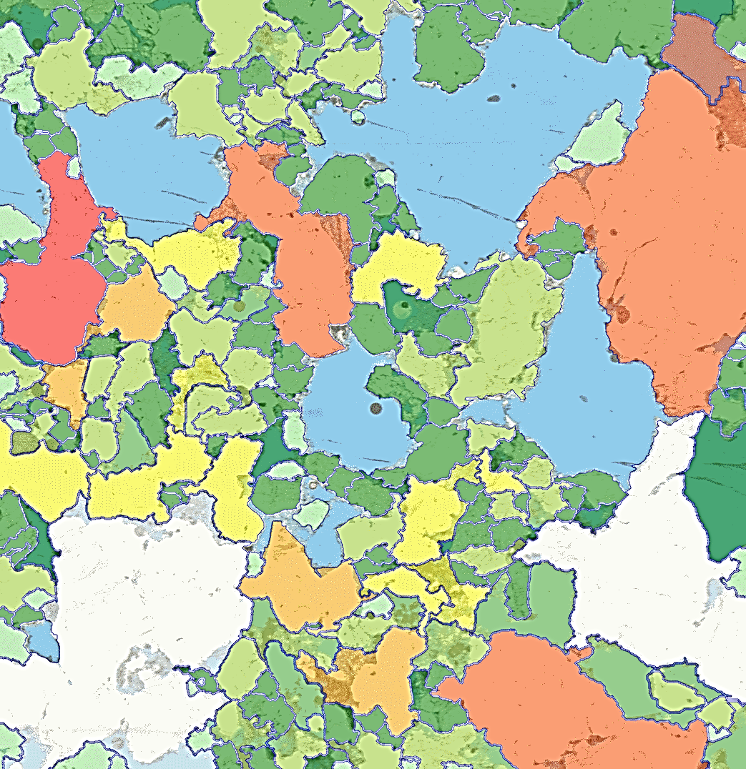
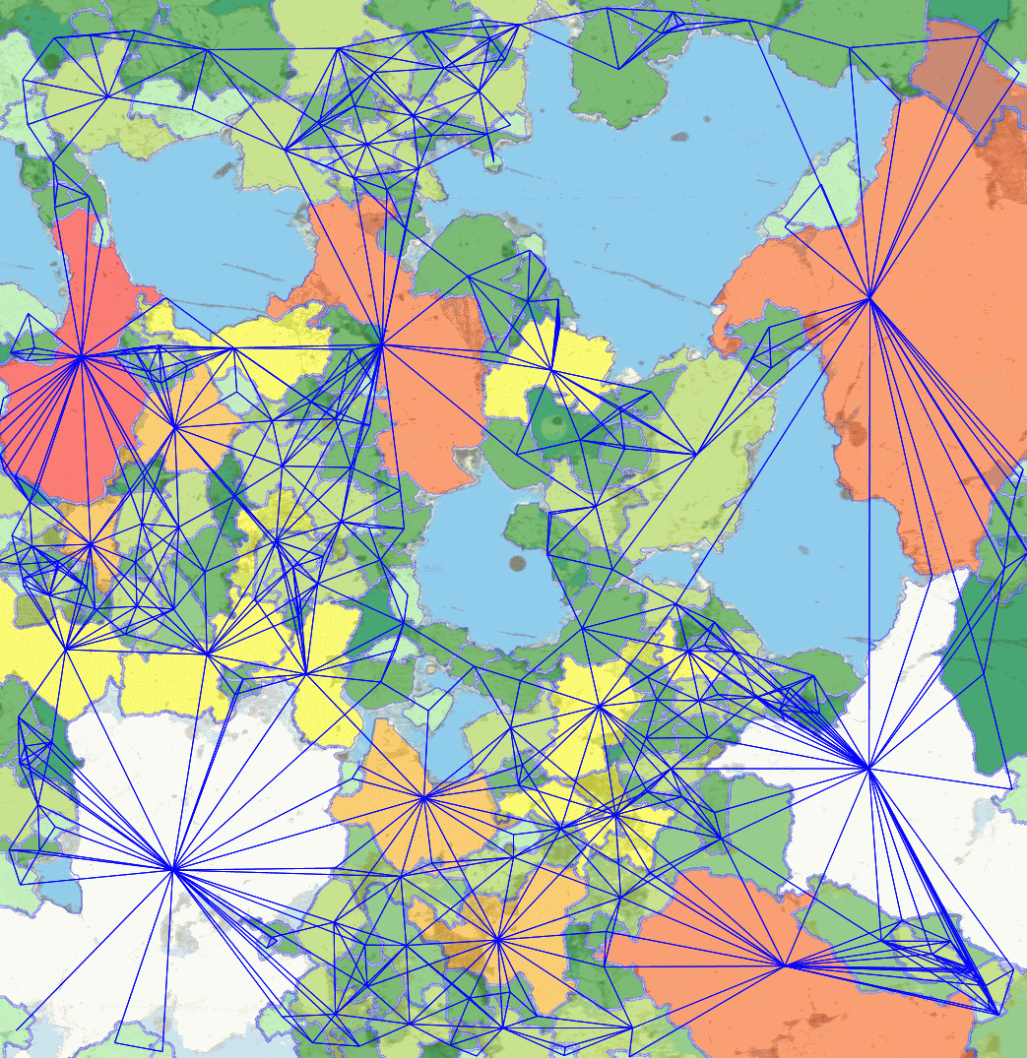
What about sandstones?
Notes:
Later, another question arrived: restoration work needs sandstone to fill missing pieces of buildings. A sandstone with high porosity is not stable enough, it will fall into pieces in a few years.
So we need to measure the stability, more exactly the average number of neighbours of the grains.
Today, many experts are measuring this manually... which is not very fast, because proper statistic needs many grains to be taken into account.
The upper left image is the thin section of the sandstone, porosities filled with blue material.
As many boundaries have too low contrast, we chose to ask the user to click into every grain once, this is shown with yellow circles. Later it was improved with an automatic suggestion and tools to add, remove or move suggested points manually.
Having this kind of hint, a well known method called seeded watershed segmentation can easily find the grain boundaries. And if it fails at some locations, we still provide tools to edit the shapes manually.
Extended with a trainable, color based porosity detection, the number of neighbours can be easily calculated, visualized for checking, and then exported into a histogram.
Again, manual supervision assures high accuracy, the software does not need to be perfect to be usable.

Slide 8
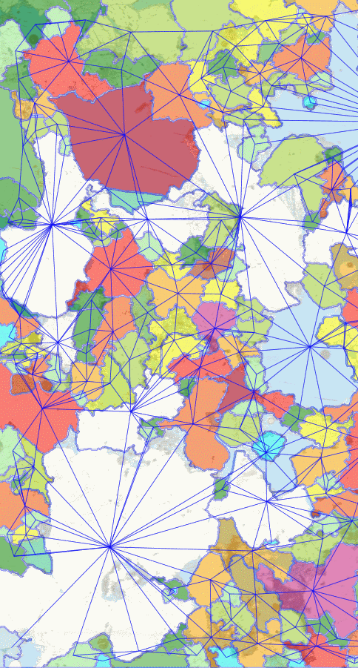
Framework
Data model
Operations
Visualization
Customizable, can utilize
domains specific knowledge
Notes:
At this point, we recognized the similarities between the marble and sandstone image analysis and started to extract the common pieces into a software framework.
A common data model was created containing
Images
Seed points
Polygons, polylines (representing grains and boundaries)
Tags on them (“selected”, “checked”)
Key-value pairs (“diameter = 1.3”, “neighbour count = 4”)
And we have a continuously growing number of operations like
Color detection learning by examples,
Boundary detection,
Manual boundary correction, and
Diameter histogram export
Using a common and universal visualization tool for our data model, creating an application for a new research project takes much less time than doing it from scratch.

Slide 9
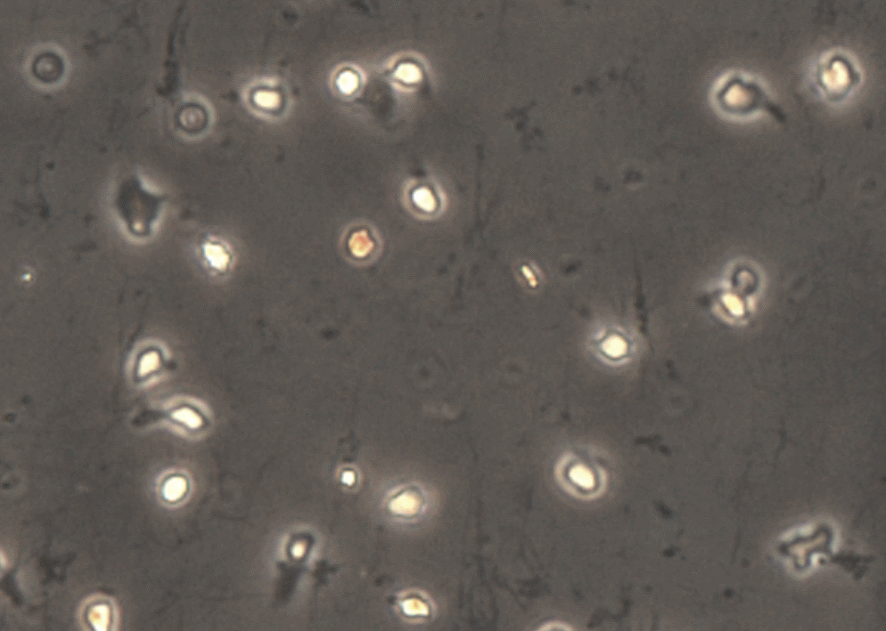
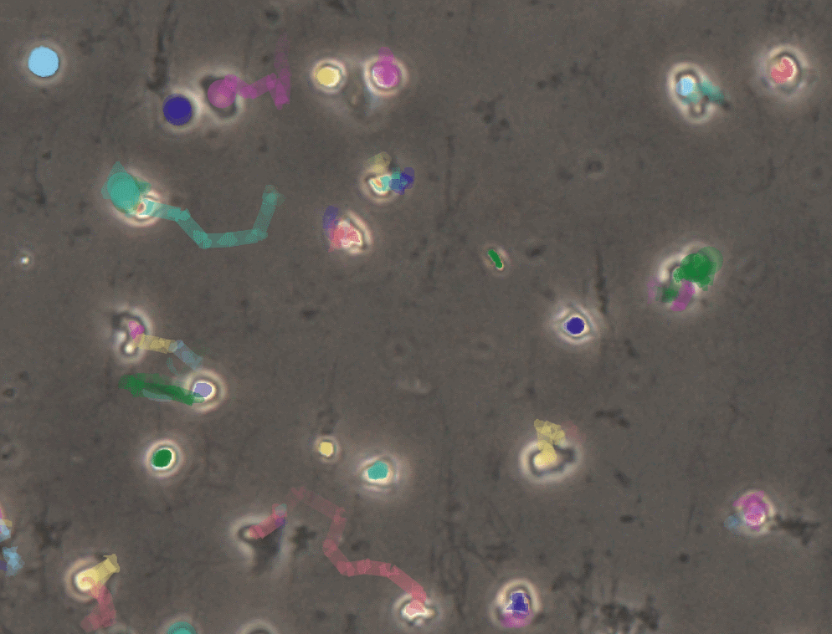
And white blood cells?
Notes:
A few months after the previous projects, a medical research team came to us.
They needed to track the motion of white blood cells in long sequences of microscopic images.
The problem with conventional motion tracking solutions was that there was too much motion between images for fully automatic tracking.
They could not make images more frequently, as there were too many samples beside each other to be handled by the robotic microscope. And reducing the number of parallel processed samples was no option either.

Slide 10
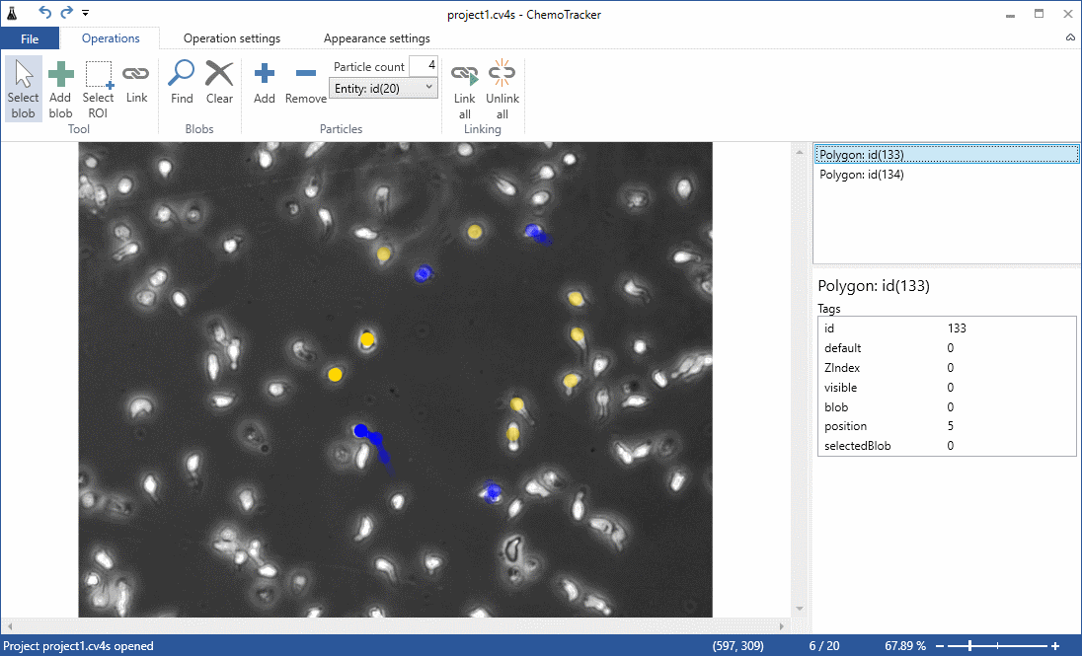
ChemoTracker application
Notes:
We created the ChemoTracker application which took the semi-automatic approach again: the user can guide the automatic tracking, or even completely override it. If the tracking is simple, it is done almost automatically. If it is harder, the user needs to step in, but they only need to fix the most complicated cell motions, leaving most cases done by the software.
In this case, the polygons are cells, instead of grains. Key-value pairs store successor cells instead of grain diameters. But the underlying data model and the visualization is the same.

Slide 11

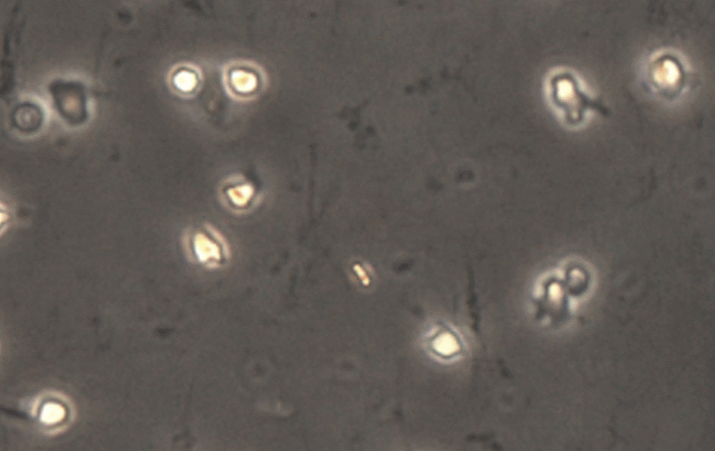
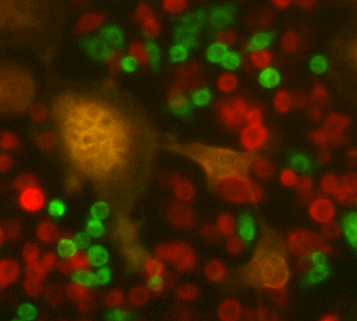
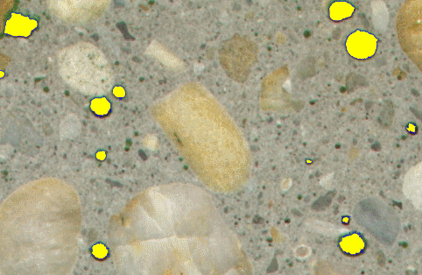
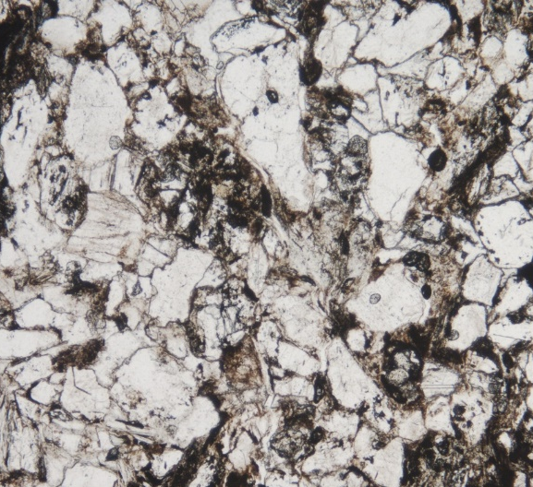
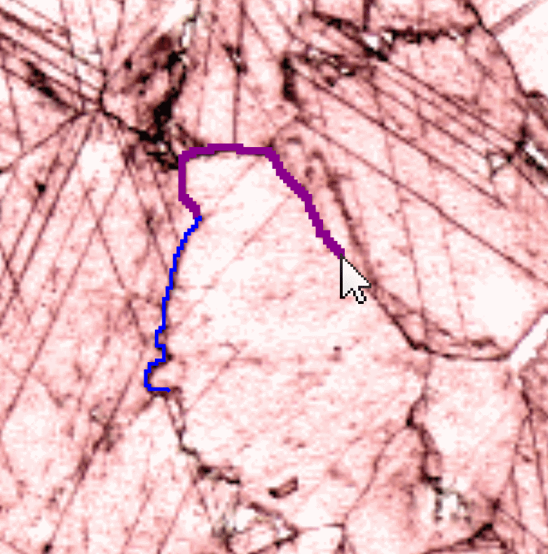
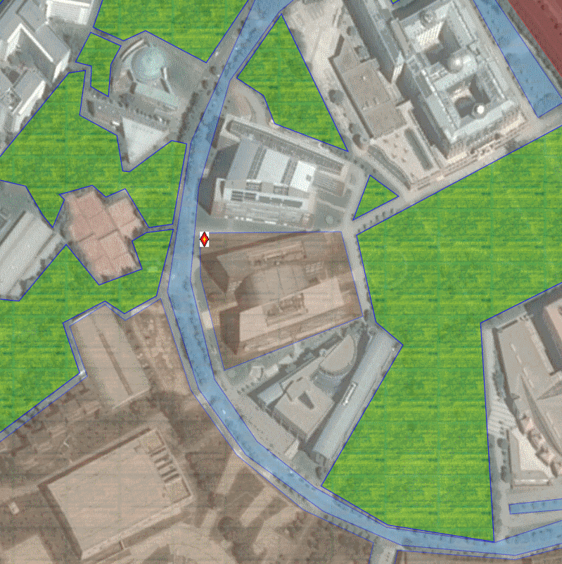
http://bmeaut.github.io/cv4sensorhub/
Notes:
These were the first three projects we started with the cv4sensorhub framework. Later, bone eating bacteria tracking, concrete porosity analysis, schist thin section analysis, and even topographic data, and industrial matchstick production came into the picture.
You can find additional information about these, together with video links and contacts on our website: http://bmeaut.github.io/cv4sensorhub/

Slide 12
Summary
We are investigating collaborations with experts in archaeometry, petrography, construction material analysis, and road fracture evaluation.
Collaborations of this kind can open up research directions which have been flagged “unfeasible” until now.
And we are open to further co-operations! ☺
Notes:
Summarizing the talk,
we believe that combining the forces with professional software developer teams can benefit in almost every research topic, and
it can open many-many interesting, interdisciplinary directions.
Thank you for your kind attention!

