Slide 1
A Wi-Fi based Architecture of a Smart Home Controlled by Smartphone and Wall Display IoT Device
Tareq Khan, Ph.D.
Assistant Professor,
Computer Engineering Technology,
School of Engineering Technology,
Eastern Michigan University,
Email: tareq.khan@emich.edu

Slide 2
Outline
Introduction
Related Works
System Architecture
Wall Display Panel
Smartphone App
Result
Conclusion

Slide 3
Introduction
In this age of smart devices, many people are carrying a smartphone with them all the time. When they are at home, most of them are connected with the home Wi-Fi network.
In this paper, a Wi-Fi network based architecture is proposed to control home appliances using a smartphone and also with a touchscreen-based wall display panel.
The proposed system enables the user to control appliances from anywhere in the home without the pain of walking towards the switch panel on the wall.
In this project, the mechanical switch based panel on the wall is replaced by the state-of-the-art touch-based liquid crystal display. Along with buttons, the display also shows current weather and time widgets.

Slide 4
Related Works
In K. Laubhan et al, the design of a Smart Power Strip is discussed where the loads can be turned on/off using a smartphone app that communicates wirelessly with the microcontroller using Bluetooth.
In X. Wen et al, a smart home environment monitoring system is designed with Raspberry Pi based smart home controller, EnOcean/Wi-Fi wireless sensor control network, and smart home PC client.
Compared with the other works, the proposed work uses the home Wi-Fi network.
As most of the smart devices such as smartphones, tablets etc. are always connected with home Wi-Fi, no additional connection such as Bluetooth, ZigBee etc. are required – which can save battery life of the phone.
Loads can be turned on/off using both smartphone app and a Wi-Fi connected LCD with a touchscreen device that can be attached on the wall – replacing the old-fashioned mechanical switch based panel.
The wall display also shows colorful weather forecast and time widgets.
To use the proposed system, the password of the home Wi-Fi network must be known to the user – thus the system is fairly secured from hacking.

Slide 5
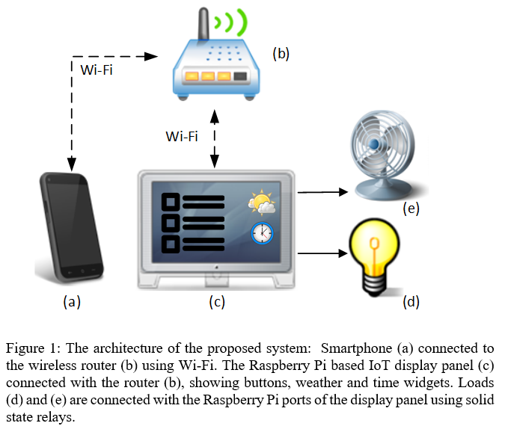
System Architecture

Slide 6
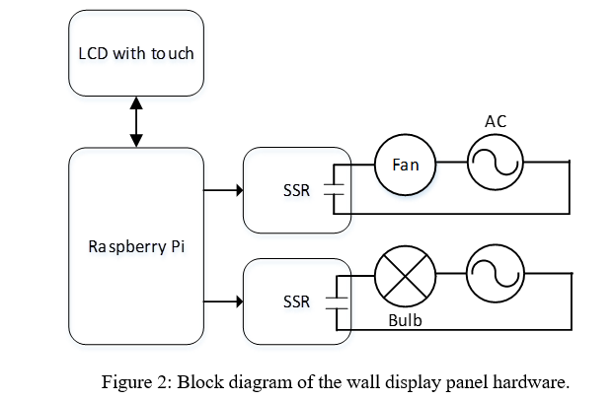
System Architecture: Wall Display Panel HARDWARE

Slide 7
System Architecture: Wall Display Panel APP
The Android Things embedded operating system is installed on a 16 GB secure digital (SD) card of the RPi board.
The app of the display panel shows
The on and off buttons for each load. The current on-off status is also displayed using labels.
The current time and weather widget on the screen. Hypertext Markup Language (HTML) code was embedded in web views of the app for fetching time and weather information from the Internet.
The wall display panel is configured as a server and the smartphone is configured as a client for socket-based data communication in the local Wi-Fi network.
The display panel’s app shows its local Internet Protocol (IP) address, so the user can input that IP in the smartphone to establish a socket connection.
The IP of the display panel is fixed to 192.168.1.20 by configuring the router, so that the smartphone does not have to reenter the display panels IP.

Slide 8
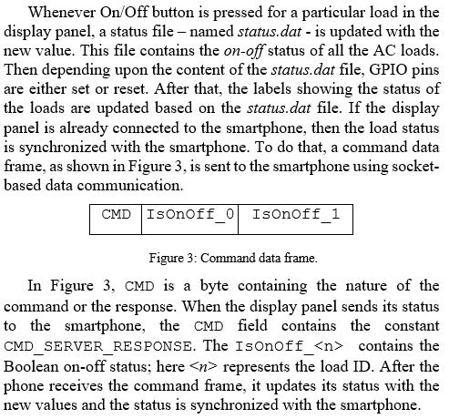
System Architecture: Wall Display Panel APP

Slide 9
System Architecture: Smartphone App
The smartphone app is developed for the Android platform.
The first screen of the app shows the on and off buttons for each load. The current on-off status is also displayed using labels.
The app contains a settings menu, where the user can input the IP of the wall display panel.
The first screen of the app contains a connect button – when pressed by the user – a socket connection is established with the display panel through the router using Wi-Fi.

Slide 10
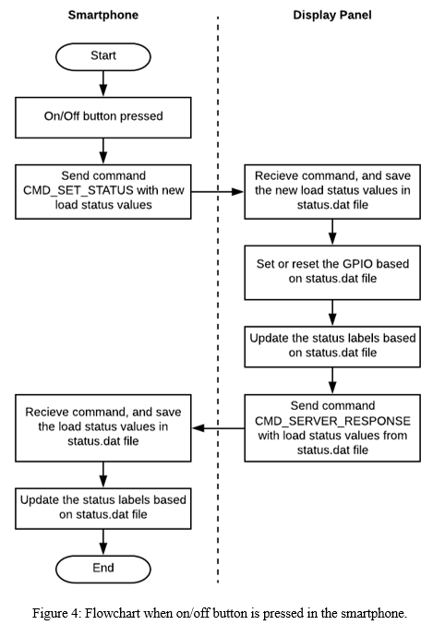
System Architecture: Smartphone App

Slide 11
Results
A prototype of the proposed Wi-Fi-based smart home control system as discussed is developed and tested successfully.
Loads can be controlled using the display panel and also with the smartphone with a 100% success rate.
The status of the smartphone app automatically gets updated when a load is controlled by the display panel and vice-versa.
Notes:
Prototype developed

Slide 12
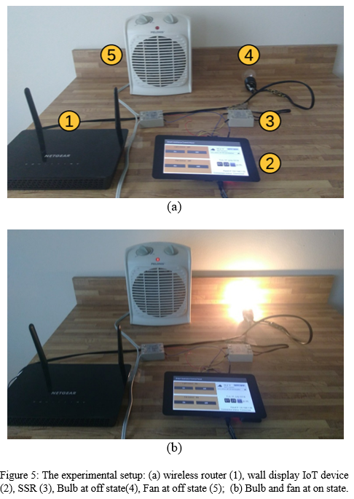
Results

Slide 13
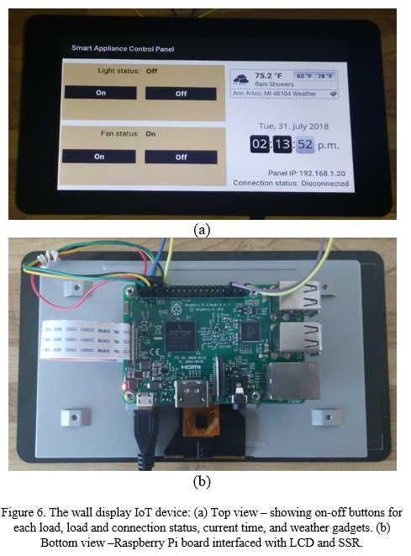
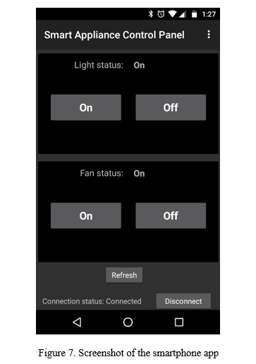
Results

Slide 14
Conclusion
In this paper, a Wi-Fi network based architecture to control home appliances using a smartphone and also with a touchscreen-based wall display panel IoT device is proposed.
A prototype of the proposed system is developed and tested.
Future work includes:
Controlling the brightness or speed of the load using Pulse Width Modulation.
A cloud-based web interface for controlling and monitoring the loads.
Interfacing temperature and humidity sensors with the display panel.

Slide 15
Thanks!

